Slide 1
TEACHER SELF-CARE

Slide 2
BE PRACTICAL
Create an AM/PM workflow
Prioritize your tasks
Continue to find organizational hacks
Schedule your time at 70%
Keep encouragement nearby
Utilize natural calendar rhythms to restart
Give yourself grace – not every lesson needs to be larger than life.

Slide 3
EMBRACE CHALELNGE & FEEDBACK
Get a regular check-in partner
Build your professional network
Attend training and conferences
Do peer observations with feedback
Submit to coaching
Consider a new grade level or subject area

Slide 4
SET BOUNDARIES
Unplug during weekends
Set boundaries with others and say NO
Set boundaries with yourself – your identity is not your job
Try to protect your school breaks
Turn off email notifications on your phone
Go home – the work will be there in the morning
Set social media limits for yourself

Slide 5
STAY HEALTHY
Go on regular health checkups
Maintain healthy habits and be accountable with others
Prioritize exercise
Utilize mental health resources
Pause when stressed and practice mindfulness
Establish a relaxing evening routine to get 7-8 hrs of sleep
If a person of faith, lean into your faith

Slide 6
HAVE FUN
Plan vacations
Have a good laugh
Work with your hands
Invest in friendships
Stay out of the teacher’s lounge
Be outside
Continue to engage in hobbies

Slide 7
THINK TRUTH
Prioritize time to journal and reflect
Wait to respond when not escalated
Have a growth mindset
Regularly celebrate small wins
Practice deliberate gratitude
Learn to let things go
Don’t take accusations or feedback as a personal attack

Slide 8
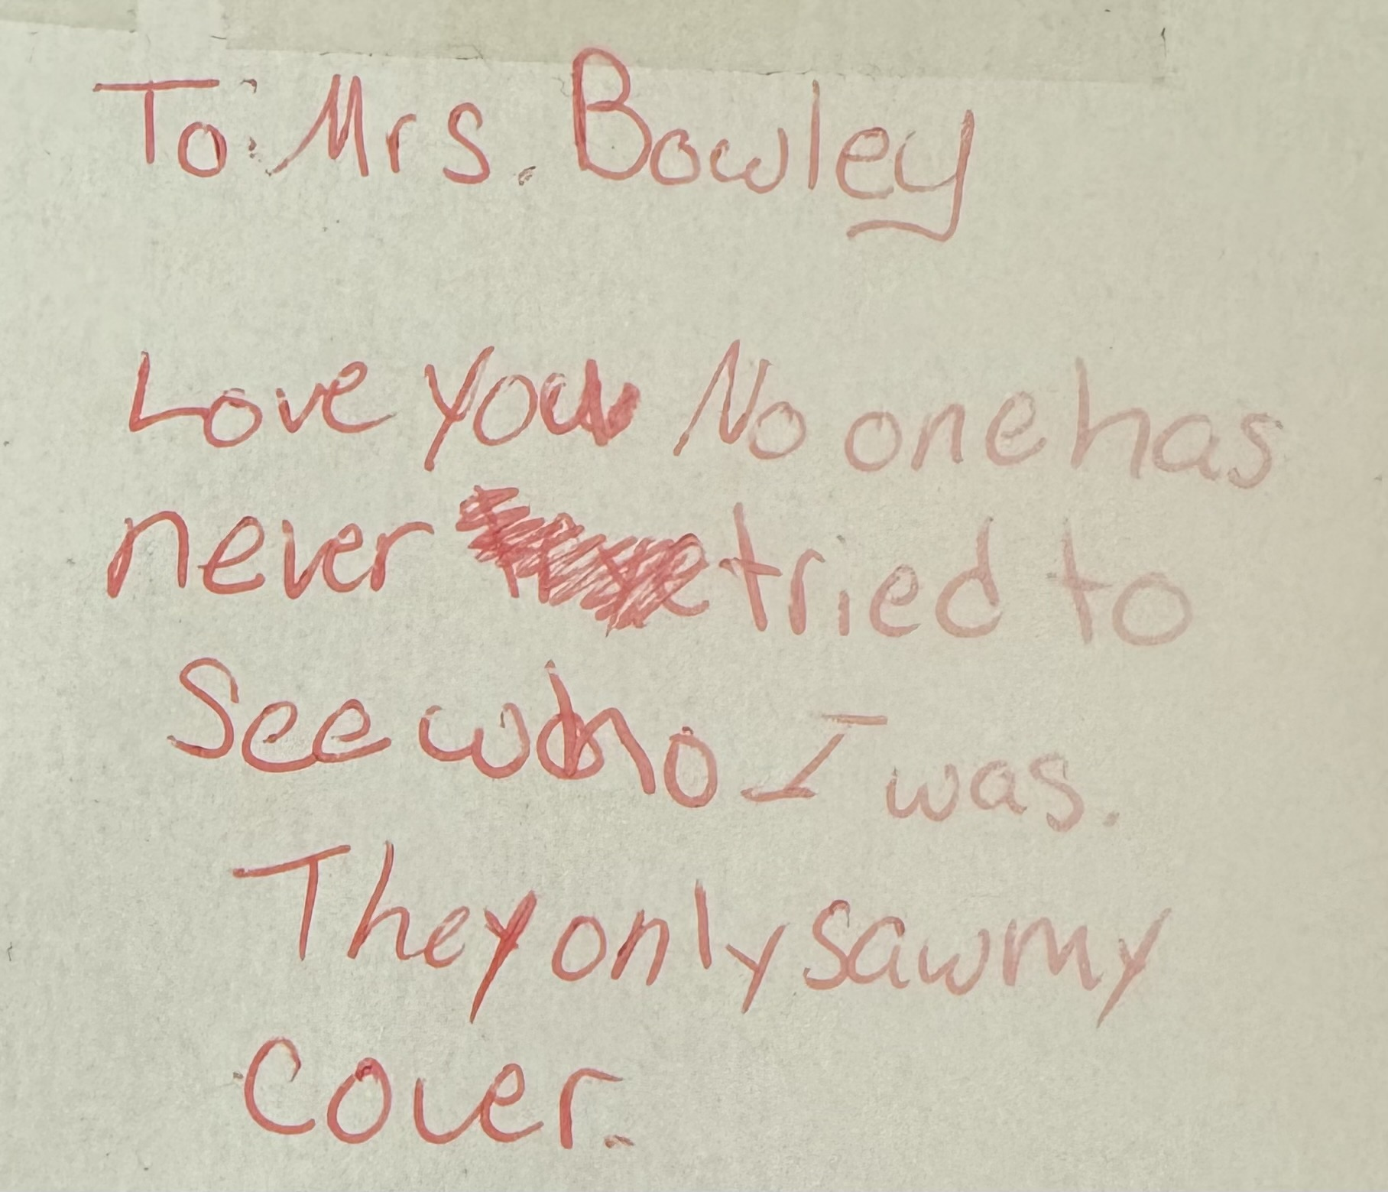
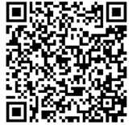
Lindsay.Bowley@cherokeek12.net

